Slide 1

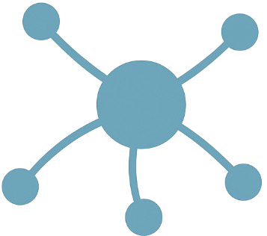
INTRODUCING The Tech-Hub Ambassador, and His Plan to Create a 24-7 AGENTIC Embassy Staff (PLUS OTHER STUFF)
Using Dynamic Agent Teams USING “STICKY” HUB DATA to Empower Sales, Guide Builders, and Connect Audiences USING “PROJECTS”

Slide 2


Executive Summary
The Tech-Hub Ambassador wants your help and permission to create a 24-7 AI Agent “Embassy Staff” —
An Agentic Swarm System that empowers Tech-Hub users, by interpreting use-cases and matching them to both
available Tech-Hub resources, other Tech-Hub Audiences and Past Usage Data (to be gathered).
Purpose: Make the Tech-Hub interactive and self-guiding
Model: Multi-agent orchestration with audience-specific teams
Outcomes: Accelerate sales, Amplify solution re-use,
Connect siloed Audiences using sticky, centralizing “Projects.”
Evolution: Tech-Hub becomes an indispensable, Living
Database of Data-Aware Solutioning Activity.
Sales
Builders
Tech-Hub Resources
“Tap your own data and get rich!”
Specialists
Infra Leads
Andrew Wells, NTT DATA Divisional President
“Give your data Agency to guide users!”
Client Reps
Mike D., Your Tech-Hub Ambassador

Slide 3

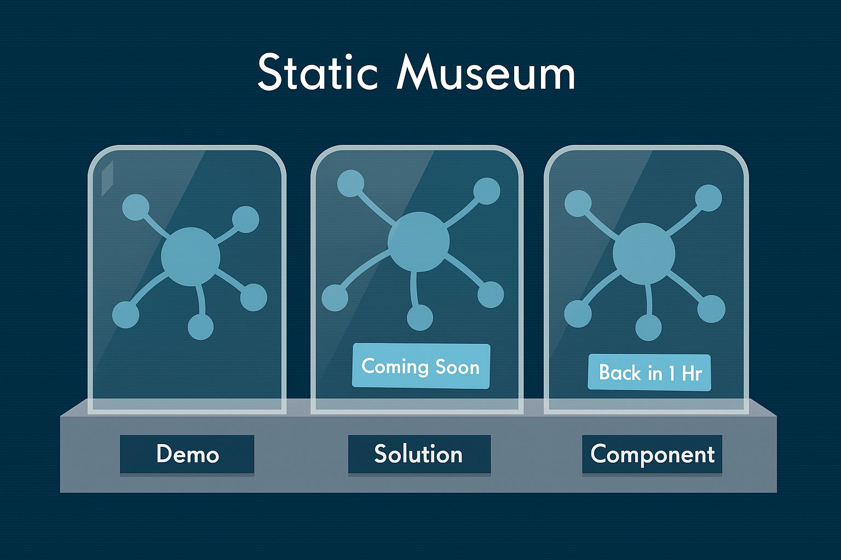
Tech-Hub: A Static Museum of Great Projects Waiting to connect…
With 30+ resources across “Demos,” “Solutions,” and “Components,” in Production and a lot more in the wings of Development, the Tech-Hub is still somewhat passive —
Like a catalog without a concierge.
🔍 New teams need to see themselves in the assets
📉 Sales need to quickly connect their use-cases to existing Tech-Hub patterns
🧠 Builders may reinvent existing solutions
🔒 Knowledge remains siloed across functions
🐢 Engagement cycles are slowed by manual exploration

Slide 4
AGENTIC ARCHITECTURE: A Dynamic Swarm of Agents
Directed by an Orchestrator Agent
Spawns specialized Agent Teams per use-case
Each Agent Team delivers tailored outcomes to its audience
Navigator
Builder
Agent Role | Function
Navigator Agent | Translates use-cases to assets
Builder Agent | Maps infrastructure, guides deploy
Research Agent | Surfaces patterns, prior projects, missing required component assets!
Concierge Agent | User-Interface: triages user needs e.g. “Start a NEW Project,” vs “Submit My project to TechHub”
Orchestrator Agent
Tech-Hub User
Concierge
Research & Archivist

Slide 5
TWO Example AGENT-TEAMS Compared: Client Sales Navigator vs Implementation Accelerator
CLIENT SALES NAVIGATOR IMPLEMENTATION ACCELERATOR
Purpose | Transform client requirements into TechHub resource recommendations
Inputs | Use-case, industry, client info, cloud preference
Outputs | Pattern match, BOM, implementation plan, linked resources
Value | Faster sales cycles, better win rates, captured use-case intel
Purpose | Help builders reuse assets and uncover gaps
Inputs | Tech specs, constraints, timelines
Outputs | Component map, integration plan, gap report
Value | Reduced dev time, higher quality builds

Slide 6
The Data That We Have, The Data THAT We need
HAVE:
We Expose Resource Data, Method?
NEED:
Who is currently using the Site?
What Components are Most Used?
Why were those picked, what Use-Cases
did they serve?
Who to contact for more info about
Successful Project Usage?
RESOURCES: Tags! Repos!
SITE-DATA:
Traffic? Conversion Rate ?
Tech-Hub DATA
TECH-HUB DATA
USE-CASES:
By Industry? Client?
UTILIZATION: By Component?
PROJECTS PAST: Successful?
Who to Contact?

Slide 7
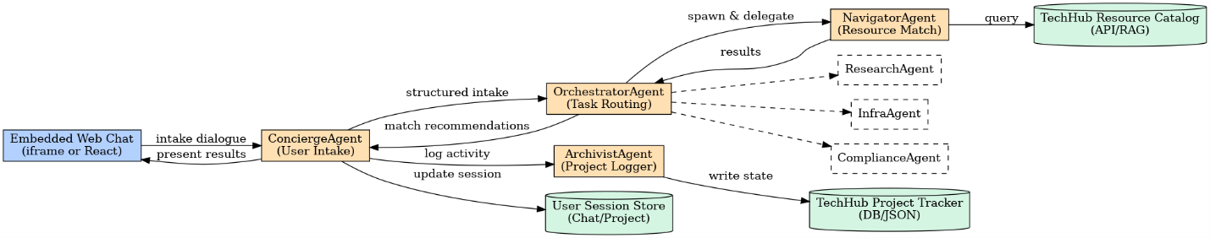
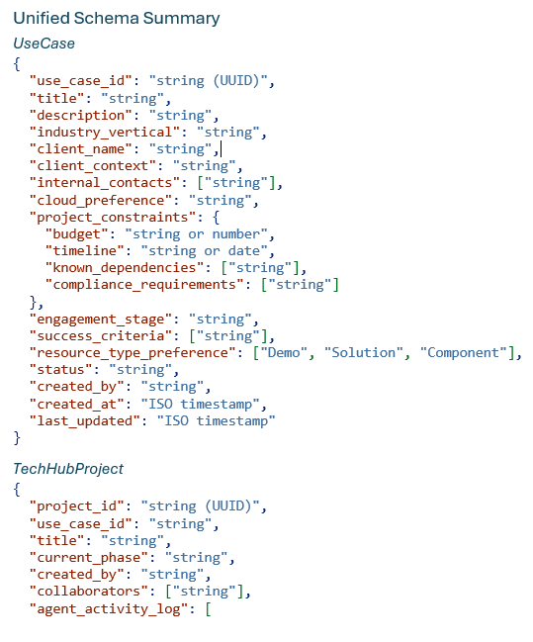
Designing “Sticky” Projects AT the HUB.
Current Code, Design-Docs and README are in the temporary Project Repo at: https://github.com/michael-s-downs/embassy_staff.git
Design-Doc is at the Project Root with README. Prototype Project Is stubbed for CosmoDB in Azure and JSON Flat-files Locally:
Minimal Data-Entity Modeling & Attribute Capture so far! Needs a Design Group Sesh to move toward a working set of completable artifacts…
Project Model minimally designed
Resource Model minimally designed
Use-Case Model minimally designed

Slide 8
OTHER IDEAS RELATED AND SUPPORTING
>1 Users desire sandbox resources to try out the Solutions and Components
This could be GATED by the proper use of Projects (Resource Approval at stage maturity)
> 1Users desire to contribute their proven patterns to the Tech-Hub!
Tracking Projects up to implementation gives us the chance to make that part of process.
This gives us the chance to develop the curation like a ‘F.O.S.S’ community
1 User (me) would like a separate discussion about how we will approach evolving Agentic Development patterns, and the place of MCP + A2A. To be discussed how Tech-Hub can play a major role in becoming the Registry and Discovery center for Autonomous Work-With-Any-Agents Agents…

